Slide 1
Police Data Challenge
The Bayes

Slide 2

The Data Analysts
Dave Ho
Santosh Tatipamula
Alexander Vu
Tyler Shockley
Luke Liu

Slide 3
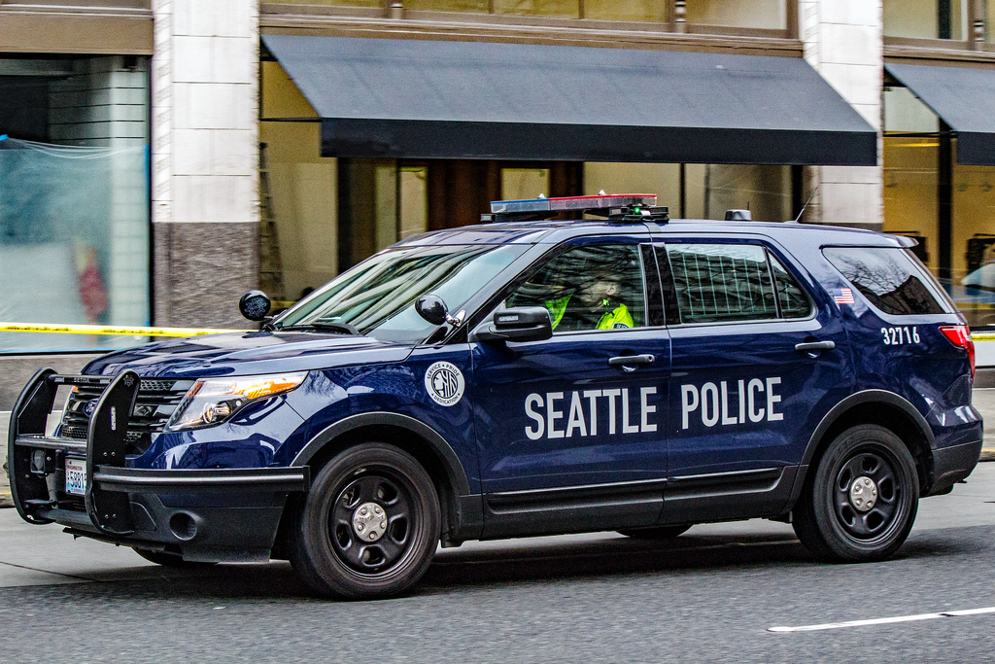
The Objective
As technology continues to grow, data becomes increasingly important
“Information is the resolution of uncertainty” ~ Claude Shannon
Predict future situations
Prioritize limited resources
In this challenge
Study existing seattle police data
Analyze the data
Come up with a possible solution to improve public safety within that area

Slide 4
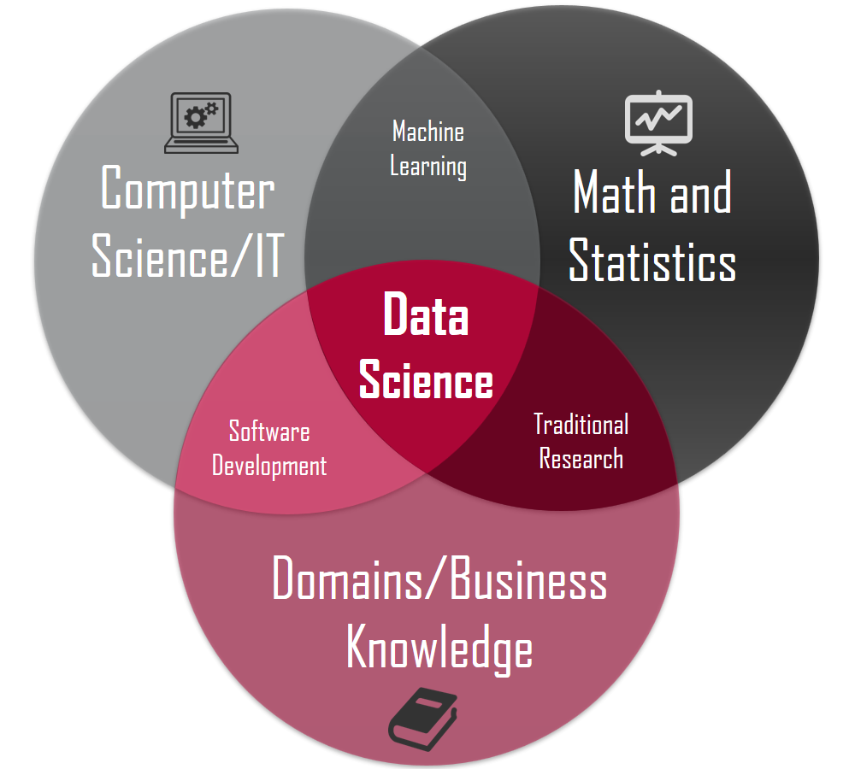
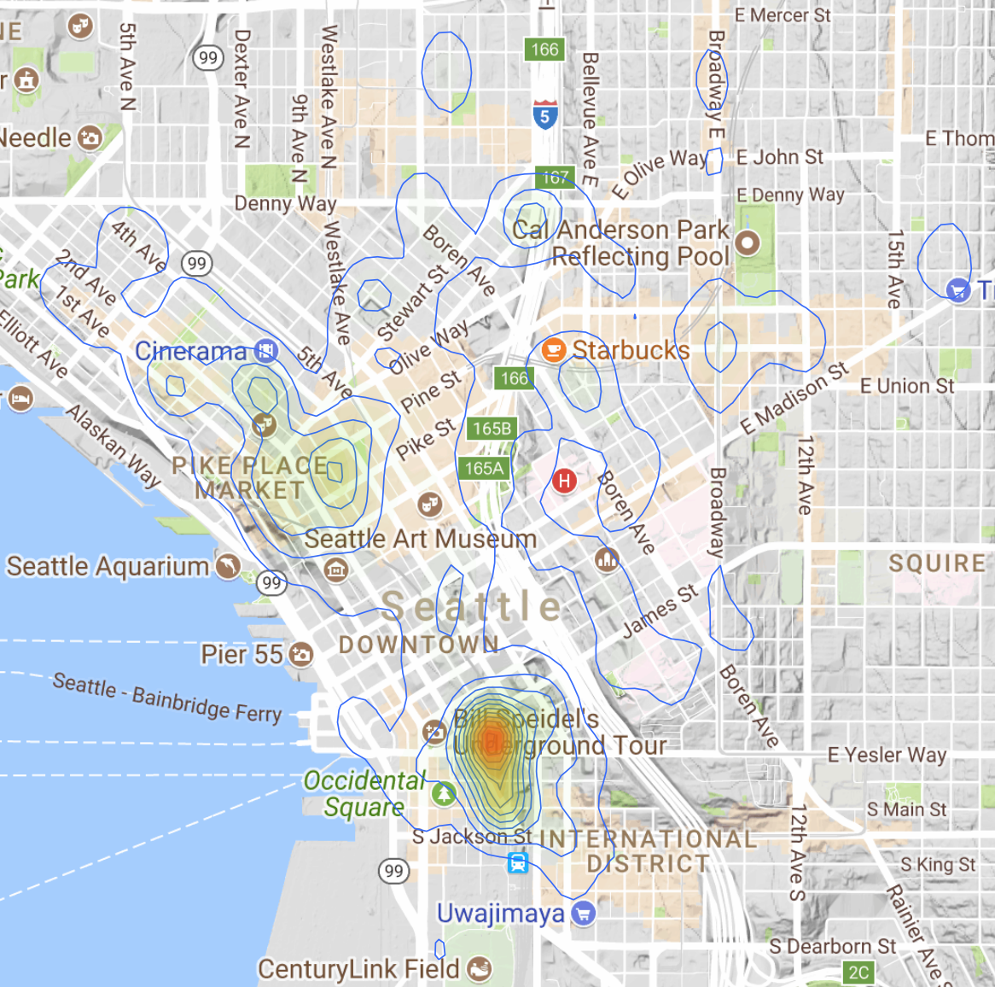
Brainstorming
Initially, we looked at Fire Data
Wanted to observe the density of fires within seattle
Based on that we could have more fire departments in a certain area, hydrants, etc.
Heat maps
However, we wanted relate more to Seattle police
Police 911 incident reports

Slide 5

Cleaning up the Data: 1
We first downloaded the file from data.seattle.gov
Unfortunately, it had 1.5 millions rows spanning 9 years (2009-2017) of data
It also had 10 columns which we did not need
R statistical programming language used to deal with large datasets
R helped us cut down the data set, cutting out 6 years of data (2009-2014) and cutting out columns, in only a few minutes

